Slide 1




Modeling Sediment Mass Distribution of the Grand Falls Dune Field
Johnelle Gonzales
Amber Gullikson, United States Geological Survey
Arizona NASA Space Grant Consortium Symposium
April 19th, 2025

Slide 2
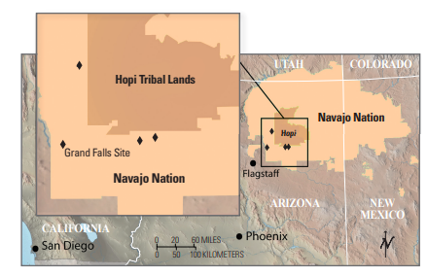
Background – Grand Falls Dune Field (GFDF)
Relatively young (<100 years)
Located ~70 km NE of Flagstaff, AZ
Bi-modal sediment
Felsic sand (quartz)
Sourced from Little Colorado River
Basaltic cinder
Sourced from nearby cinder cones
http://sgst.wr.usgs.gov/dunes//

Slide 3
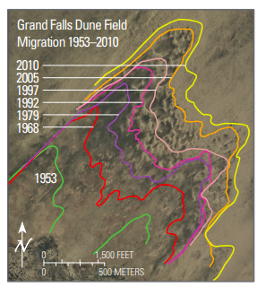
Motivations
Analog site for Mars and other planetary surface with dune-like features
How do dunes form and grow in aeolian environments on Mars?
Rapidly growing dune field
What are future affects on tribal lands nearby?
How will this dune field continue to grow?
http://sgst.wr.usgs.gov/dunes//

Slide 4
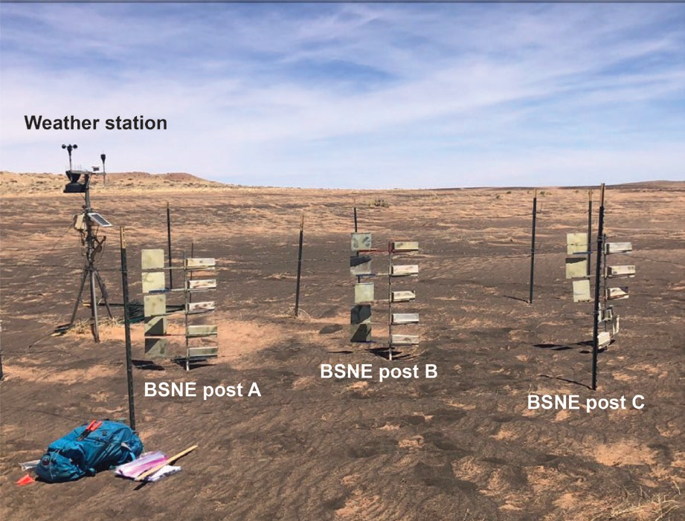
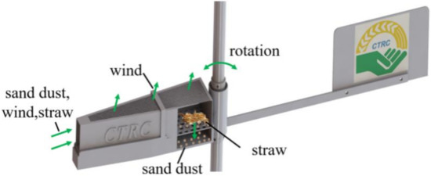
Methods
Sediment Collection
Big Spring Number Eight (BSNE)
15 total
https://doi.org/10.3390/agriculture12050703
http://sgst.wr.usgs.gov/dunes//

Slide 5
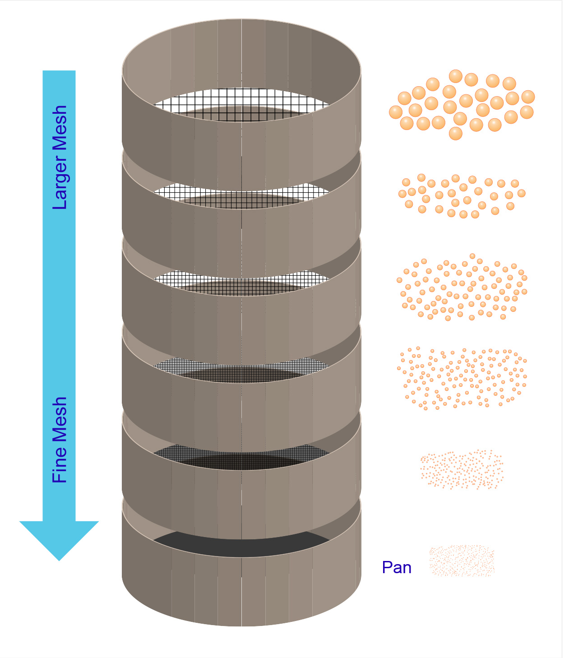
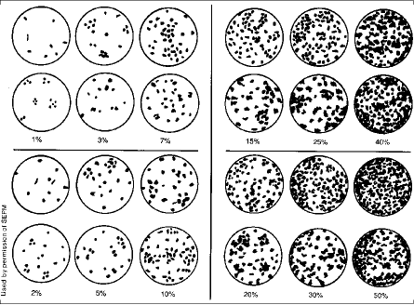
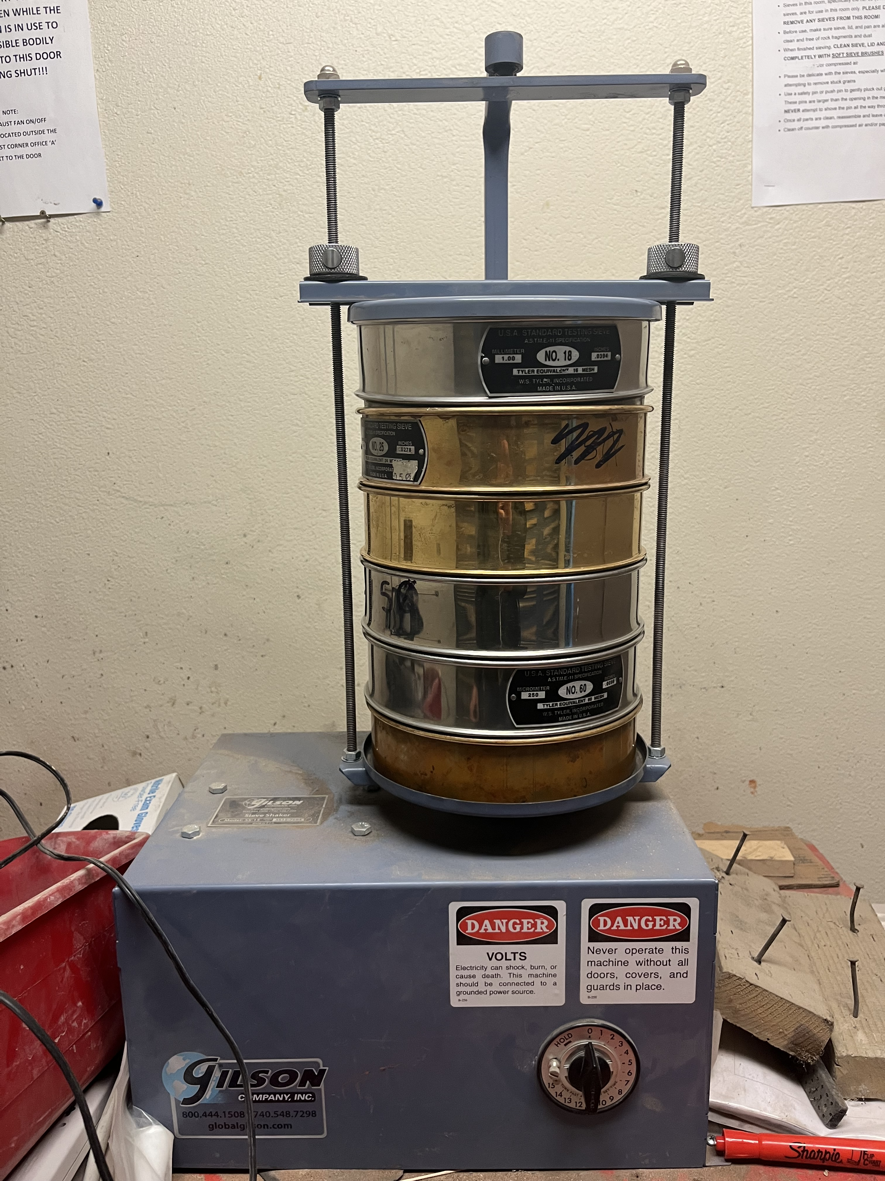
Methods
Sediment Sieving
10 bin sizes (≥ 1 mm to < 45 um)
Weight and Modal %
https://particletechlabs.com/analytical-testing/sieve-analysis/

Slide 6
Results

Slide 7
Results

Slide 8
Results

Slide 9
Results

Slide 10
Conclusions
Higher transportation heights contain more small grain sizes
Mafic cinder is predominantly larger in grain size
More likely to be transported via creep and saltation
Felsic sand is predominantly smaller in grain size
More likely to be transported via saltation and suspension
Future Work:
Remeasure some sample, analyze more samples, incorporate more accurate modal %
Fit data to functions to understand height boundaries for transportation modes
Incorporate wind velocity data to understand sediment flux

Slide 11
Thank you!

Slide 12
More data

